Slide 1
SQL 2.3

Slide 2
Learning Outcomes
Mastering Common Table Expressions (CTEs) and Window Functions for efficient data manipulation in SQL.
Understanding and applying aggregate functions for summarizing data effectively.
Utilizing row numbers and various ranking functions for data sequencing and ranking.
Transitioning data seamlessly between MySQL and Python using DataFrames.
Familiarity with DB Browser's interface and its integration with Python for streamlined data handling.

Slide 3
Common Table Expression (CTE)
In SQL, a Common Table Expression (CTE) is a quick way to make a temporary table from a basic SELECT statement. It helps keep things neat and efficient in your queries.
CTEs in SQL provide a concise and organized way to simplify complex queries by creating temporary result sets.

Slide 4
Common Table Expression (CTE)
Syntax :
WITH my_cte AS (
SELECT a,b,c
FROM T1
)
SELECT a,c
FROM my_cte
WHERE condition…
Virtual Table
Main Query

Slide 5
Common Table Expression (CTE) Example
Let's continue with the previous example of the employees table from employees.db.
Classify employees into salary ranges (Low, Medium, High) based on their individual salary within each department. Display the department number, employee name, job title, and the respective salary range.

Slide 6
Common Table Expression (CTE) Example
WITH EmployeeSalaryRanges AS(
— CTE query
SELECT dept AS department_number,name AS employee_name,job,sal,
CASE WHEN sal < 30000 THEN 'Low'
WHEN sal >= 30000 AND sal < 50000 THEN 'Medium'
WHEN sal >= 50000 THEN 'High'END AS salary_range
FROM employees )
— Main query
SELECT * FROM EmployeeSalaryRanges;

Slide 7
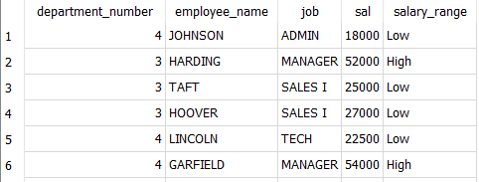
Common Table Expression (CTE) Example 1
Virtual Table

Slide 8
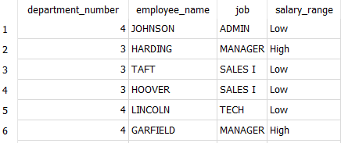
Common Table Expression (CTE) Example 1
Main Query

Slide 9
Common Table Expression (CTE) Example 2
Database Link : store.db
Imagine you, as a data scientist, are tasked with identifying the top 5 customers by analyzing their purchase details.
In this case, we will utilize the ‘purchase’ table within the store.db database.

Slide 10
Common Table Expression (CTE) Example 2
WITH TopCustomers AS (
SELECT customer_id, SUM(total_amount) AS total_spent
FROM purchase
GROUP BY customer_id
ORDER BY total_spent DESC
LIMIT 5
)
SELECT * FROM TopCustomers;

Slide 11
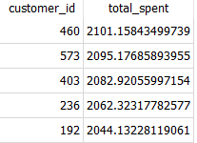
Common Table Expression (CTE) Example 2

Slide 12
Task 1: Exploring Departmental Averages
Let say, you are working as a data scientist at XYZ Company, you were asked to delve into the company's employee data to gain insights into departmental salary averages. Your first task was to create a clear picture of the average salary for each department.

Slide 13
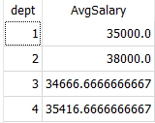
Task 1: Calculate the average salary for each department
WITH DepartmentAvgSalary AS (
SELECT dept, AVG(Sal) AS AvgSalary
FROM employees
GROUP BY dept
)
SELECT * FROM DepartmentAvgSalary;

Slide 14
Task 2: Identifying High Earners
Your findings led to the next intriguing question - Who among our employees earns more than the average salary across all departments? This prompted you to construct a query to identify employees with salaries above the calculated average.

Slide 15
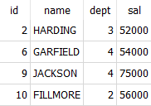
Task 2: Find employees with salaries above the average salary
WITH AverageSalaries AS (
SELECT AVG(Sal) AS AvgSalary
FROM employees
)
SELECT id, Name, dept, Sal
FROM employees
WHERE Sal > (SELECT AvgSalary FROM AverageSalaries);

Slide 16
Windows Analytical Functions
Window functions operate on a set of rows related to the current row within a query result, enabling calculations across those rows without changing the overall result set.
Unlike regular aggregate functions, window functions return multiple rows for each group or window.
Examples include RANK, DENSE_RANK, ROW_NUMBER, and aggregate functions like AVG or SUM can also function as window functions.

Slide 17
Windows Analytical Functions
Syntax :
SELECT
col1,
col2,
window_function() OVER (PARTITION BY partition_column ORDER BY order_column) AS result_column
FROM
your_table;

Slide 18
Types of Windows Analytical Functions
Aggregate Functions
MAX()
MIN()
SUM()
AVG()
COUNT()
Ranking Functions
ROW_NUMBER()
RANK()
DENSE_RANK()
NTILE()
PERCENT_RANK()
CUME_DIST()

Slide 19
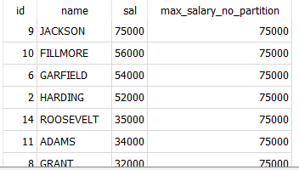
Aggregate Functions MAX() without PARTITION BY
SELECT
id, name, sal,
MAX(sal) OVER (ORDER BY sal DESC) AS max_salary_no_partition
FROM
employees;

Slide 20
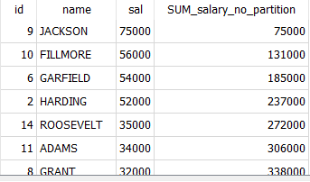
SUM() without PARTITION BY (Order By Only)
SELECT
id, name, sal,
SUM(sal) OVER (ORDER BY sal DESC) AS SUM_salary_no_partition
FROM
employees;

Slide 21
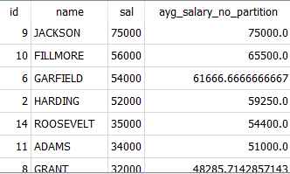
AVG() without PARTITION BY (Order By Only)
SELECT
id, name, sal,
AVG(sal) OVER (ORDER BY sal DESC) AS ayg_salary_no_partition
FROM
employees;

Slide 22
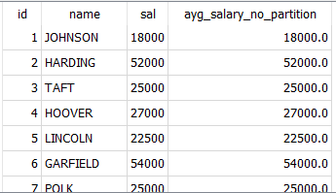
AVG() with PARTITION BY
SELECT
id, name, sal,
AVG(sal) OVER (PARTITION BY id ORDER BY sal DESC) AS ayg_salary_no_partition
FROM
employees;

Slide 23
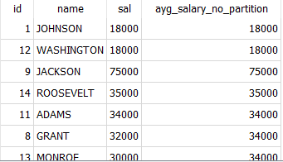
MAX() with PARTITION BY
SELECT
id, name, sal,
MAX(sal) OVER (PARTITION BY job ORDER BY sal DESC) AS ayg_salary_no_partition
FROM
employees;

Slide 24
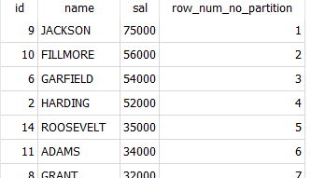
Without Partition (Only Order By) Examples:
SELECT
id, name, sal,
ROW_NUMBER() OVER (ORDER BY sal DESC) AS row_num_no_partition
FROM
employees;

Slide 25
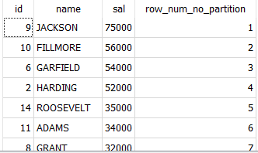
RANK() without PARTITION BY (Order By Only)
SELECT
id,name,sal,
RANK() OVER (ORDER BY sal DESC) AS row_num_no_partition
FROM
employees;

Slide 26
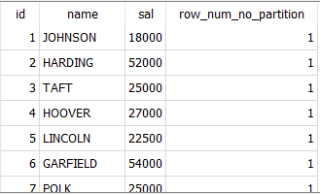
ROW_NUMBER() with PARTITION BY
SELECT
id, name, sal,
ROW_NUMBER() OVER (PARTITION BY id ORDER BY sal DESC) AS row_num_no_partition
FROM
employees;

Slide 27
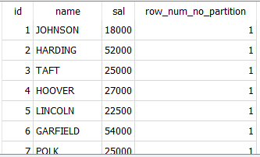
RANK() with PARTITION BY
SELECT
id, name, sal,
RANK() OVER (PARTITION BY id ORDER BY sal DESC) AS row_num_no_partition
FROM
employees;

Slide 28
Connecting MySQL to Python
MySQL is a popular open-source relational database management system.
Python provides various libraries to interact with MySQL databases, and one of the commonly used libraries is mysql-connector-python, which allows seamless integration between Python and MySQL.

Slide 29
Connecting MySQL to Python
For this you will need to install mysql-connector-python. You can install by using following command on command prompt:
pip install mysql-connector-python
A complete guide connecting MySQL to python is given the following jupyter file : Mysql2Python

Slide 30
Connecting SQLite to Python
SQLite is a lightweight, file-based SQL database engine that is easy to set up and use.
Python provides a built-in module called sqlite3 that allows seamless integration with SQLite databases.
It enables users to perform SQL operations, such as creating databases, executing queries, and manipulating data, directly from Python code.

Slide 31
Connecting SQLite to Python
For this you will need to install sqlite python connector. You can install by using following command on command prompt:
pip install db-sqlite3
A complete guide connecting sqlite to Python is given in the following jupyter file: DB2python.ipynb

Slide 32
Summary
The session covered advanced SQL techniques, emphasizing Common Table Expressions (CTEs), Window Functions, and aggregate functions for efficient data manipulation. Understanding row numbers, ranking functions, and their applications facilitated effective data sequencing. Additionally, transitioning data between MySQL and Python using DataFrames and leveraging DB Browser for streamlined data handling were key takeaways from the session.

Slide 33
Thank You!

